Slide 1
Bayesian linear modelling for ecology and evolution in R
glm to MCMCglmm

Slide 2
Bayesian linear modelling for ecology and evolution in R
glm to MCMCglmm

Slide 3
Bayesian linear modelling for ecology and evolution in R
glm to MCMCglmm

Slide 4
Bayesian linear modelling for ecology and evolution in R
glm to MCMCglmm

Slide 5
Bayesian linear modelling for ecology and evolution in R
glm to MCMCglmm

Slide 6
Bayesian linear modelling for ecology and evolution in R
glm to MCMCglmm

Slide 7
Bayesian linear modelling for ecology and evolution in R
glm to MCMCglmm

Slide 8
Linear model
y = β₀ + β₁x₁
β₀ is the intercept
β₁ is the slope
y
β₀
β₁
x₁
x₁

Slide 9
Linear model
y = β₀ + β₁x₁
β₀ is the intercept
β₁ is the slope
y
β₀
β₁
x₁
x₁

Slide 10
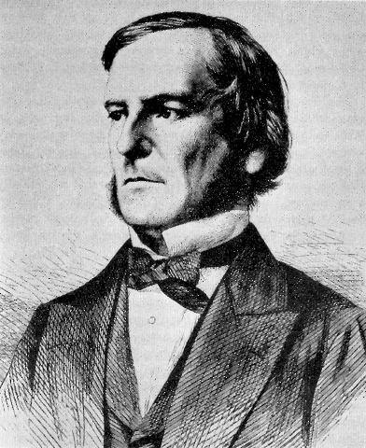
Linear model
Boolean
y
y = β₀ + β₁x₁ + β₂x₂
β₀ is the intercept
β₁ is the slope
Β₀ + Β₂
β₀
β₁
β₁
x₁
x₁

Slide 11
Linear model
Boolean
y
y = β₀ + β₁x₁ + β₂x₂
β₀ is the intercept
β₁ is the slope
β₀
β₁
x₁

Slide 12
Generalized Linear model
y
y = Xβ + e
e = residual error
β₀
β₁
x₁

Slide 13
Bayesian linear modelling for ecology and evolution in R
glm to MCMCglmm

Slide 14
Bayesian linear modelling for ecology and evolution in R
glm to MCMCglmm

Slide 15
Generlized Linear model
y = Xβ + e
y
x₁

Slide 16

Generlized Linear model
y = Xβ + e
y
x₁

Slide 17
Generlized Linear model
y = Xβ + Zu + e
Zu = random effect
y
Zu
x₁

Slide 18
Bayesian linear modelling for ecology and evolution in R
glm to MCMCglmm

Slide 19
Bayesian
Thomas Bayes
1702-61

Slide 20

Bayesian
?
Thomas Bayes
1702-61

Slide 21
Bayes Theorem
P(E|H)
P(H)
P(H|E)
=
P(E)

Slide 22
Probability of
H given E
P(E|H)
P(H)
P(H|E)
=
P(E)

Slide 23
Posterior
probability
P(E|H)
P(H)
P(H|E)
=
P(E)

Slide 24
The Likelihood
P(E|H)
P(H)
P(H|E)
=
P(E)

Slide 25
The Prior
P(H)
P(E|H)
P(H|E)
=
P(E)

Slide 26
P(E|H)
P(H)
P(H|E)
=
P(E)
The probability of E over all possibilities

Slide 27
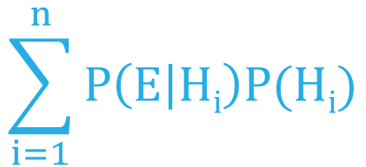
P (E|H)
P (H)
P (H|E)
=
$$\sum_{i=1}^{n}{P\left(E | Hi\right)P(Hi)}$$
The probability of E over all possibilities

Slide 28
Lucky for us we can forget the bottom and use
P(H|E)
P(E|H)
P(H)
~

Slide 29
Bayesian linear modelling for ecology and evolution in R
glm to MCMCglmm

Slide 30
Bayesian linear modelling for ecology and evolution in R
glm to MCMCglmm

Slide 31
glm to Monte CarloMCglmm

Slide 32

glm to Monte CarloMCglmm

Slide 33
Bayesian linear modelling for ecology and evolution in R
glm to MCMCglmm

Slide 34
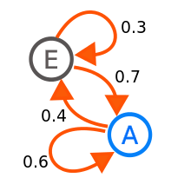
glm to MCMarkov Chainglmm

Slide 35
Monte Carlo Markov Chain
y = Xβ + Zu + e

Slide 36


Monte Carlo Markov Chain
y = Xβ + Zu + e

Slide 37


Monte Carlo Markov Chain
X₀
y = Xβ + Zu + e

Slide 38
Monte Carlo Markov Chain
X₀
y = Xβ + Zu + e

Slide 39
Monte Carlo Markov Chain
X₀
X_{t}
y = Xβ + Zu + e

Slide 40
P(H|E)
P(E|H)
P(H)
~

Slide 41
Monte Carlo Markov Chain
X₀
X_{t}
y = Xβ + Zu + e
P(E|X_{t})
P(X_{t})
P(E|X₀)
P(X_{o})

Slide 42
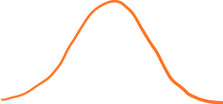
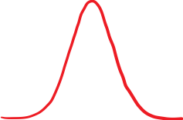

Priors
y = Xβ + Zu + e

Slide 43


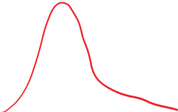
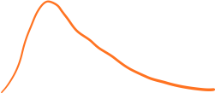
Priors
y = Xβ + Zu + e

Slide 44
Monte Carlo Markov Chain
X₀
X_{t}
y = Xβ + Zu + e
P(E|X_{t})
P(X_{t})
P(E|X₀)
P(X_{o})

Slide 45
Monte Carlo Markov Chain
X₀
X_{t}
y = Xβ + Zu + e
P(E|X_{t})
P(X_{t})
P(E|X₀)
P(X_{o})

Slide 46

Monte Carlo Markov Chain
X₀
X_{t}
y = Xβ + Zu + e
P(E|X_{t})
P(X_{t})
P(E|X₀)
P(X_{o})
>1
X_{t}

Slide 47
Monte Carlo Markov Chain
X₀
X_{t}
y = Xβ + Zu + e
P(E|X_{t})
P(X_{t})
P(E|X₀)
P(X_{o})
<1
Go to X_{t}
with the probability
P(E|X_{t})
P(X_{t})
P(E|X₀)
P(X_{o})

Slide 48



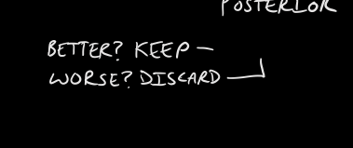
Monte Carlo Markov Chain
X₀
X_{t}
y = Xβ + Zu + e
P(E|X₀)
P(X₀)
P(E|X_{t})
P(X_{t})
P(E|X_{t1})
P(X_{t1})
P(E|X_{tx})
P(X_{tx})

Slide 49
Monte Carlo Markov Chain
X₀
X_{t}
y = Xβ + Zu + e
P(E|X₀)
P(X₀)
P(E|X_{t})
P(X_{t})
P(E|X_{t1})
P(X_{t1})
P(E|X_{tx})
P(X_{tx})

Slide 50
Remember this guy
P (E|H)
P (H)
P (H|E)
=
$$\sum_{i=1}^{n}{P\left(E | Hi\right)P(Hi)}$$
The probability of E over all possibilities

Slide 51
P (X_{t}|E)
=
P (X₀|E)

Slide 52
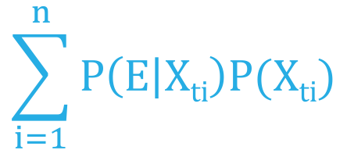
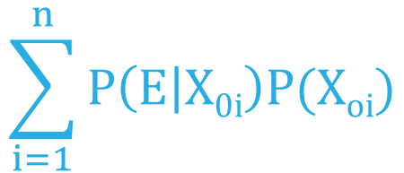
P (E|X_{t})
P (X_{t})
$$\sum_{i=1}^{n}{P\left(E | Xti\right)P(Xti)}$$
P (X_{t}|E)
=
=
P (X₀|E)
P (E|X₀)
P (X₀)
$$\sum_{i=1}^{n}{P\left(E | X0i\right)P(Xoi)}$$

Slide 53
P (E|X_{t})
P (X_{t})
$$\sum_{i=1}^{n}{P\left(E | Xti\right)P(Xti)}$$
P (X_{t}|E)
=
=
P(E|X_{t})
P(X_{t})
P (X₀|E)
P(E|X₀)
P(X_{o})
P (E|X₀)
P (X₀)
$$\sum_{i=1}^{n}{P\left(E | X0i\right)P(Xoi)}$$

Slide 54
Monte Carlo Markov Chain
X₀
X_{t}
y = Xβ + Zu + e
P(X_{t})
Posterior X_{t}
Posterior X₀
P
Posterior X_{t2}
Posterior X_{t1}

Slide 55
Why bother?

Slide 56
Philosophical approaches to probability

Slide 57
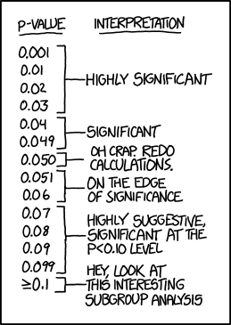

Slide 58
Flexible of the models

Slide 59
JAGS WinBUGS/BUGS STAN
Lots of programs/languages

Slide 60
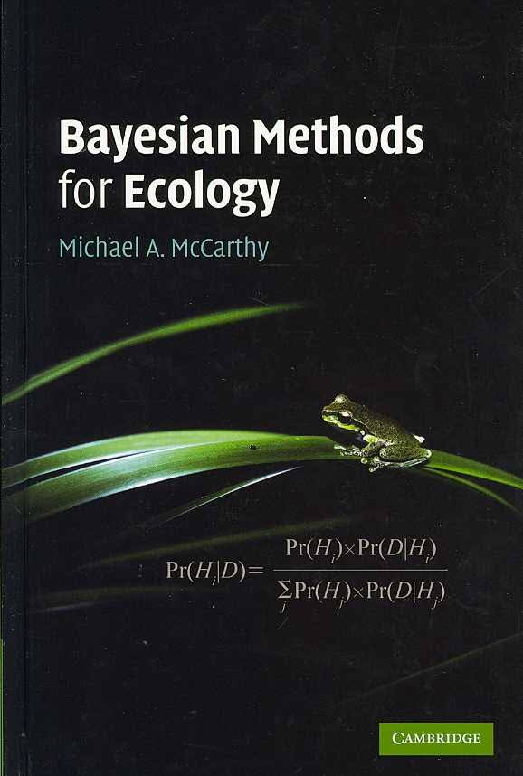

Slide 61
Lets do some examples

